Slide 1
Discussion Unit:
Introduce the DSE Operations Center
Adding and expanding clusters
Configuring nodes
Viewing performance metrics
Correcting issues
Monitoring cluster health
Configure security
Backup and recovery
Other
DSE Ops Center
Notes:
The goal of this Discussion Unit is introduce DSE Operations Center; a Web based management and monitoring tool for DSE clusters.

Slide 2
Discussion Lab:
DSE, DSE Ops Center Communication Protocols/Architecture
Refrigerator Magnets - Match the terms on the right with the boxes on the left

Slide 3




DSE, Ops Center: Communication Protocols/Arch
Ops Center
Server
agent
node 0
C:
JMX
A:
ODBC
Http
Stomp
B:
B:
DSE Cluster
Sec-28, Sub-D
A:
CQL/Native
node 2
node 1
agent
E:
agent
Browser
C:
D:
0000-DTSE-OpsCenter-6250-DU-60-3
Notes:
Refrigerator magnets Discussion Lab: detailing (one) DSE object hierarchy-
Match the terms on the right with the lettered boxes on the left.
Stomp protocol, https://en.wikipedia.org/wiki/Streaming_Text_Oriented_Messaging_Protocol
Security Protocol 28 Subsection D, In the event of a hostile takeover of a Starship, the EMH is to deactivate and await rescue, http://www.ditl.org/regulations-list.php

Slide 4
End of Discussion Lab:
Notes:
End of Discussion Lab-

Slide 5
Ops Center Communication Architecture
Ops Center
Server
agent
CQL/Native
node 0
Http
Stomp
Stomp
DSE Cluster
Http
node 2
node 1
agent
agent
Browser
CQL/Native
JMX
0000-DTSE-OpsCenter-6250-DU-60-5
0000-DTSE-OpsCenter-6250-DU-60-5
Notes:
Ops Center server provides a thin client Web app supporting one or more users, one or more DSE clusters.
Ops Center agents must operate on every node in the DSE cluster. The Ops Center agents may be manually or automatically installed.
Reference Urls,
https://docs.datastax.com/en/opscenter/6.5/opsc/opscArchOvr.html

Slide 6




Ops Center Install Methods
Ops Center installation methods include the following:
Tar ball install (Practice Lab 6251 to follow)
Docker install
Linux Yum/APT-GET
Notes:
DSE Ops Center can be installed via a variety of methods.
In Practice Lab 6251 that follows, we detail a Tar ball install of Ops Center and the Ops Center agent.

Slide 7
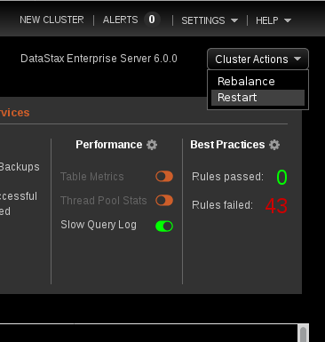
Ops Center: Cluster Ops
Ops Center capabilities relative to clusters include:
Add an existing cluster, or create a new cluster
Disconnecting an existing cluster form Ops Center and Lifecycle Manager
Rebalancing a cluster
Restarting a cluster
Generating diagnostic data for a cluster
Other
Notes:
DSE Ops Center has the ability to perform the activities listed above.

Slide 8
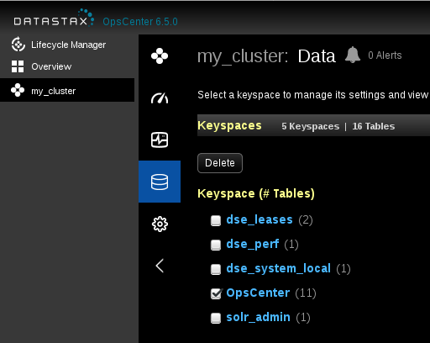
Ops Center: Keyspace Ops
Ops Center capabilities relative to keyspaces include:
View/change keyspace settings
Delete keyspaces
Other
Notes:
DSE Ops Center has the ability to perform the activities listed above.

Slide 9
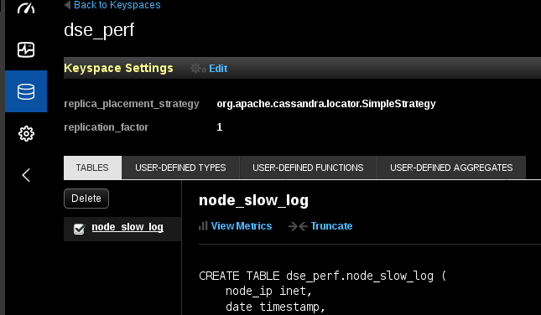
Ops Center: Table Ops
Ops Center capabilities relative to tables include:
View table metrics
Delete a table
Truncate a table
Other
Notes:
DSE Ops Center has the ability to perform the activities listed above.

Slide 10
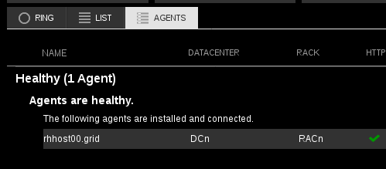
Ops Center: Agent Ops
Ops Center capabilities relative to agents include:
View agent status
Install/upgrade agents
Other
Notes:
DSE Ops Center has the ability to perform the activities listed above.

Slide 11
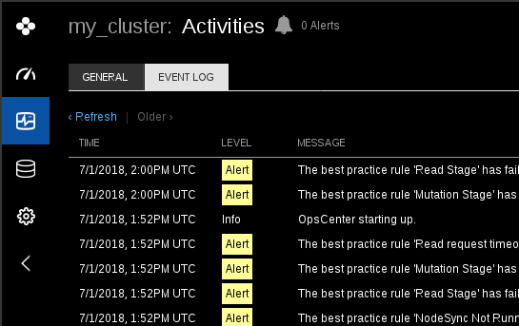
Ops Center: Alerts/Events
Ops Center capabilities relative to alerts/events include:
Set logging level per; 0/Debug thru Alert/5.
Specify SNMP alert parameters
Specify SMTP alert parameters
Specify Http/POST alert parameters
Other
Notes:
DSE Ops Center has the ability to perform the activities listed above.

Slide 12
Ops Center: Performance Metrics
Ops Center capabilities relative to performance metrics include:
Cluster wide performance metrics (metrics aggregated atop nodes)
Pending task metrics; compactions, other
Table performance metrics
Tiered storage performance metrics
Message latency metrics
Search performance metrics
Graph metrics
Nodesync metrics
Thread pool metrics
Dropped messages metrics
OS performance metrics
Alert metrics
Notes:
DSE Ops Center has the ability to perform the activities listed above.

Slide 13
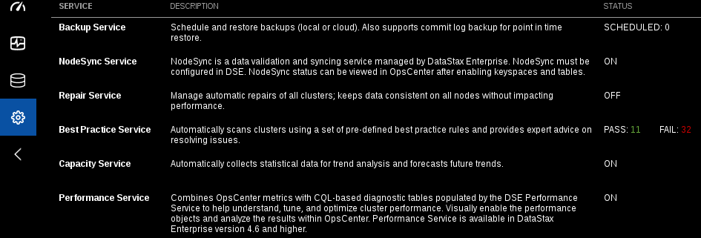
Ops Center: Management Services
Notes:
Backup Service
The Backup Service provides automatic scheduled backup, manual backup, and manual restore of DSE cluster data.
NodeSync Service
Monitor keeping keyspace and table replicas synchronized with the OpsCenter NodeSync Service for DSE versions 6.0 and later.
Repair Service
The Repair Service performs repairs across a DataStax Enterprise cluster with minimal impact to cluster performance.
Capacity Service
Using trend analysis and forecasting, the Capacity Service helps you understand cluster performance within its current environment and workload, and gain a better sense of how time affects those trends, both past and future.
Best Practice Service
The Best Practice service allows scheduling pre-defined best practice rules that check various properties of clusters and environments, reporting which active rules pass or fail a configured scan.
Performance Service
The OpsCenter Performance Service combines OpsCenter metrics with CQL-based diagnostic tables populated by the DSE Performance Service to help understand, tune, and optimize cluster performance. Visually enable the performance objects and analyze the results within OpsCenter.
Reference Urls,
https://docs.datastax.com/en/opscenter/6.5/
https://docs.datastax.com/en/opscenter/6.5/opsc/online_help/services/datastaxServices.html

Slide 14

Ops Center: Best Practice Rules Reference
Easily 40+ Rules; Examples ..
Checks that the default cassandra superuser and password has been changed from the default.
Checks that you are not using SimpleStrategy for any keyspaces in a multi-datacenter environment.
Checks to make sure SimpleSnitch isn't used in production.
Checks for secondary indexes with too many distinct values.
Others
Maury Atwater, President of Atwater's
Notes:
The Best Practice Service lists over 40 rules. Examples as shown.
Reference Urls,
https://docs.datastax.com/en/opscenter/6.5/opsc/online_help/services/BPRreference.html

Slide 15
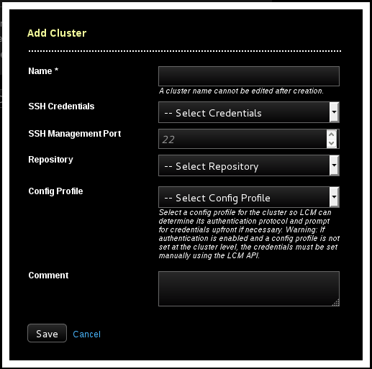
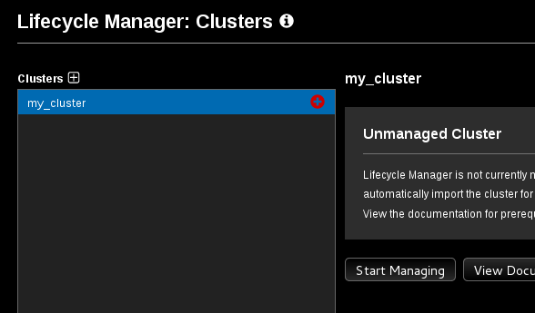
Ops Center: Lifecycle Manager (LCM)
Notes:
Lifecycle Manager (LCM) is used for provisioning DataStax Enterprise (DSE) clusters and centrally managing configurations. Simplify deploying and configuring DataStax Enterprise clusters with Lifecycle Manager.
Clusters
Create and manage the DataStax Enterprise cluster topology model in the Clusters workspace of Lifecycle Manager. Run install and configure jobs at the cluster, datacenter, or node level. Run DSE upgrade jobs at the datacenter or node level.
Jobs
View a summary and drill into details of install, configure, upgrade, and import jobs in Lifecycle Manager. Monitor the progress of running jobs. Troubleshoot failed and abort idle jobs.
Repositories
Repositories use predefined credentials for automatically downloading Debian or RPM packages from the DataStax Enterprise repository or from a private repository that is an internal mirror of the DataStax repository.
SSH Credentials
SSH credentials allow securely connecting to machines without repeatedly entering credentials for each DataStax Enterprise install, configure, or import job. Define SSH credentials for cluster, datacenter, or node levels.
Configuration Profiles
Define centrally-managed configuration profiles to enforce uniform configuration at the cluster, datacenter, or node level. Lifecycle Manager configuration options Configuration options available in opscenterd.conf for Lifecycle Manager.
Reference Urls,
https://docs.datastax.com/en/opscenter/6.5/opsc/LCM/opscLCM.html

Slide 16
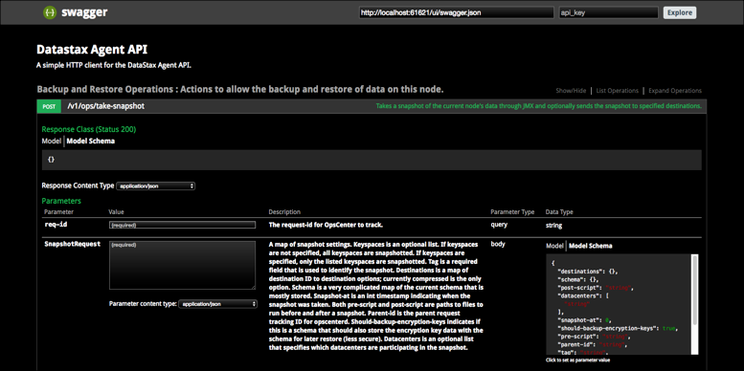
Ops Center: Agent API
Edit the agent address.yaml
swagger_eabled: true
Restart agent
localhost:61621/ui
Notes:
While we know we can administer DSE using DSE Ops Center, and by using JMX directly (or nodetool, other, directly), there is now a means to administer DSE through a new DSE Ops Center agent API. Details as shown.
Reference Urls,
https://docs.datastax.com/en/opscenter/6.5/opsc/enableAgentAPI.html

Slide 17
Notes:
End of Discussion Module-

